Slide 1



Airbnb's Accommodation Recommendation System
Airbnb, the leading platform for vacation rentals and unique accommodations, has developed an advanced recommendation system to help guests find the perfect place to stay. This presentation will explore the different types of recommendation systems and how Airbnb leverages them to provide personalized and relevant recommendations.
Rohan krishna surapaneni | AP22110010248
Notes:
1

Slide 2

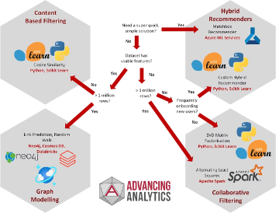
Introduction to Recommendation Systems
1
What are Recommendation Systems?
2
Purpose of Recommendation Systems
3
Importance in Airbnb
Airbnb's recommendation system is crucial for helping guests find the perfect vacation rental from its vast inventory of unique properties.
Recommendation systems are algorithms that analyze user preferences and behaviors to suggest products, services or content that a user might find interesting or useful.
They help users discover new items, improve customer experience, and increase engagement and conversions for businesses.
Notes:
2

Slide 3
Types of Recommendation Systems
Content-Based Filtering
Collaborative Filtering
Hybrid Approach
Recommends items similar to the ones a user has liked or interacted with in the past.
Recommends items based on the preferences and behaviors of similar users.
Combines content-based and collaborative filtering to leverage the strengths of both methods.
Notes:
3

Slide 4

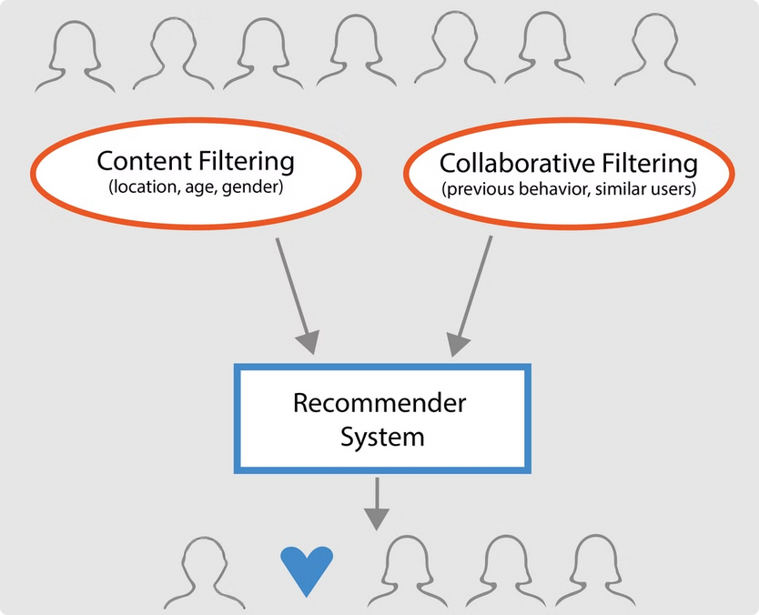
Content-Based Filtering
1
User Preferences
Analyzes a user's past preferences and interests to find similar items.
2
Item Features
Matches item attributes, such as property type, location, and amenities, to the user's preferences.
3
Personalized Recommendations
Provides recommendations based on the user's unique profile and past behaviors.
Notes:
4

Slide 5

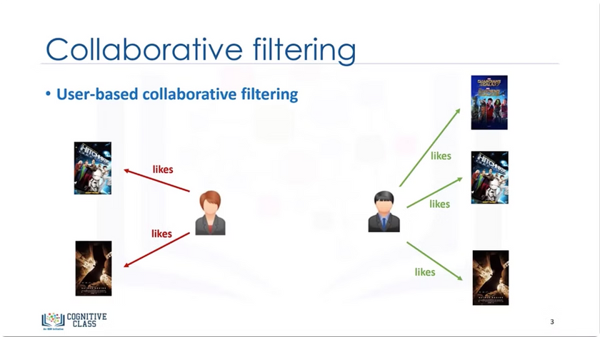
Collaborative Filtering
1
User-User Similarity
Identifies users with similar preferences and recommends items they have liked.
2
Item-Item Similarity
Finds items that are often purchased or viewed together and recommends them.
Community-Driven Recommendations
3
Leverages the collective preferences of the user community to provide recommendations.
Notes:
5

Slide 6

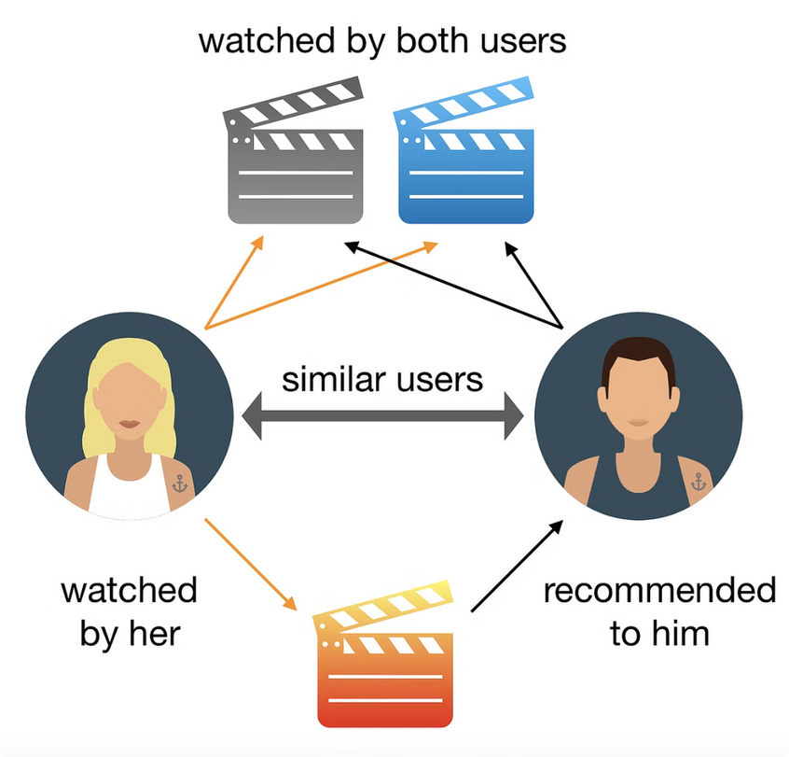
Hybrid Recommendation Systems
Combining Approaches
Leveraging Strengths
Hybrid systems use a mix of content-based and collaborative filtering techniques to provide more accurate and diverse recommendations.
The hybrid approach can overcome the limitations of individual recommendation methods and provide better overall performance.
Flexibility and Customization
Improved Accuracy
The combination of different recommendation techniques can lead to more accurate and relevant recommendations.
Hybrid systems can be tailored to the specific needs and requirements of the business and its users.
Notes:
6

Slide 7






Airbnb's Recommendation Approach
Personalization
Destination Recommendations
Airbnb leverages user data and preferences to provide personalized recommendations.
The system suggests destinations and neighborhoods based on user's travel history and preferences.
Property Recommendations
AI-Powered
Airbnb's recommendations consider property attributes, reviews, and guest preferences.
Airbnb's recommendation system leverages advanced machine learning and AI algorithms.
Notes:
7

Slide 8
Data Sources and Features
User Data
Property Data
External Data
Airbnb collects user profiles, search history, booking data, and reviews to understand user preferences.
The system analyzes property details, such as location, amenities, pricing, and ratings, to match user needs.
Airbnb also leverages third-party data sources, such as weather, events, and local recommendations, to enhance its recommendations.
Notes:
8

Slide 9





Personalization and Customization
User Profiles
Airbnb creates detailed user profiles based on their preferences, past bookings, and interactions.
Real-Time Adaptation
The recommendation system adjusts in real-time as users interact with the platform, providing more relevant suggestions.
Contextual Factors
Airbnb's recommendations consider factors like location, dates, group size, and occasion to provide the most suitable options.
Notes:
9

Slide 10


Challenges and Limitations
1
Cold Start Problem
2
Scalability
Providing relevant recommendations for new users or properties with limited data can be challenging.
Handling the massive volume of user data and properties while maintaining low latency is a significant engineering challenge.
3
Balancing Relevance and Diversity
4
Privacy and Ethics
Ensuring recommendations are both relevant to the user and diverse enough to expose them to new options.
Airbnb must ensure its recommendation system respects user privacy and aligns with ethical principles.
Notes:
10

